Slide 1
An Introduction to Social Network Analysis
Yi Li
2012-6-1

Slide 2
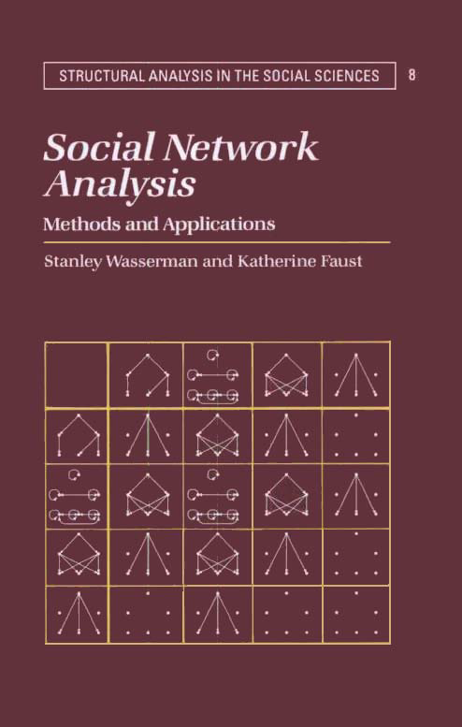
Source
Publish Year: 1994
Cited: 12400+ (Google Scholar)
This is a reference book … a comprehensive review of network methods … can be used by researchers who have gathered network data and want to find the most appropriate method by which to analyze them. -- Preface

Slide 3
Outline
Mathematical Preliminaries
Methods
Centrality and Prestige
Structural Balance
Cohesive Subgroups
Possible Applications in Our Work

Slide 4
Outline
Mathematical Preliminaries
Methods
Centrality and Prestige
Structural Balance
Cohesive Subgroups
Possible Applications in Our Work

Slide 5
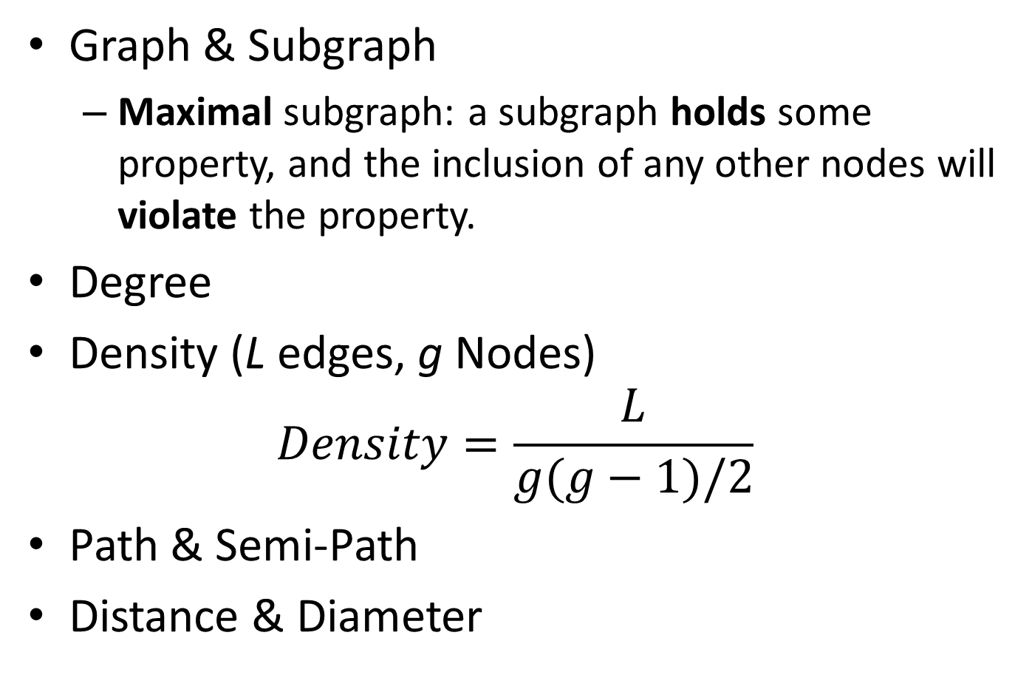
Graph Theory
Graph & Subgraph
Maximal subgraph: a subgraph holds some property, and the inclusion of any other nodes will violate the property.
Degree
Density (L edges, g Nodes) $Density=\frac{L}{g(g−1)/2}$
Path & Semi-Path
Distance & Diameter

Slide 6
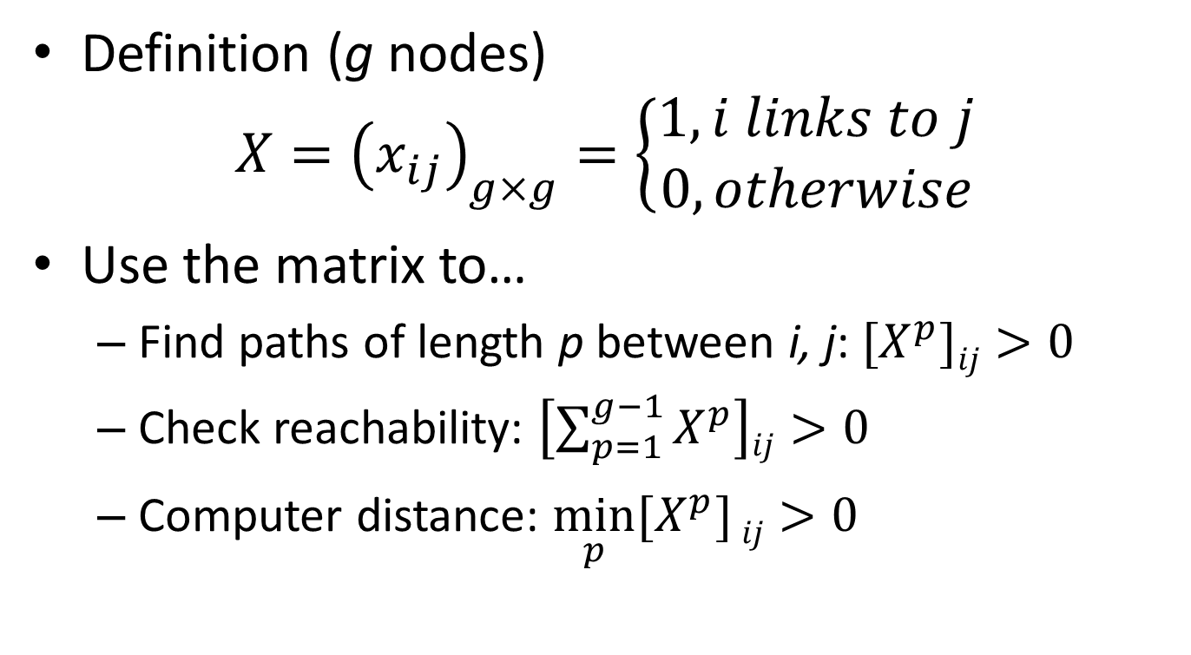
Incidence Matrix for a Graph
Definition (g nodes) $X={\left(x_{ij}\right)}_{g×g}=\left\{\begin{aligned}1, i links to j \\ 0, otherwise\end{aligned}\right.$
Use the matrix to…
Find paths of length p between i, j: ${[X}_{}^{p}]ij>0$
Check reachability: $\left[\sum_{p=1}^{g−1}{X^{p}}\right]ij>0$
Computer distance: $\min_{p}{[X^{p}]}ij>0$

Slide 7
Outline
Mathematical Preliminaries
Methods
Centrality and Prestige
Structural Balance
Cohesive Subgroups
Possible Applications in Our Work

Slide 8
Overview
Measure the prominence of actors
For undirected graph, measure centrality
For directed graph, measure centrality and prestige
Four centrality measures
Three prestige measures
Measure individuals → Aggregate to groups

Slide 9
What do we mean by “prominent”?
An actor is prominent ⬄ The actor is most visible to other actors
Two kinds of actor prominence / visibility
Centrality To be visible is to be involved
Prestige To be visible is to be targeted
Group centralization = How different the actor centralities are (How unequal the actors are)?

Slide 10

Centrality (1): Actor Degree Centrality
Idea: Central actors are the most active
Calculation: For actor n_{i} $C_{D}\left(n_{i}\right)=\frac{d(n_{i})}{g−1}$
Degree of n_{i}
Max possible degree of an actor (g actors in total)
A star graph

Slide 11
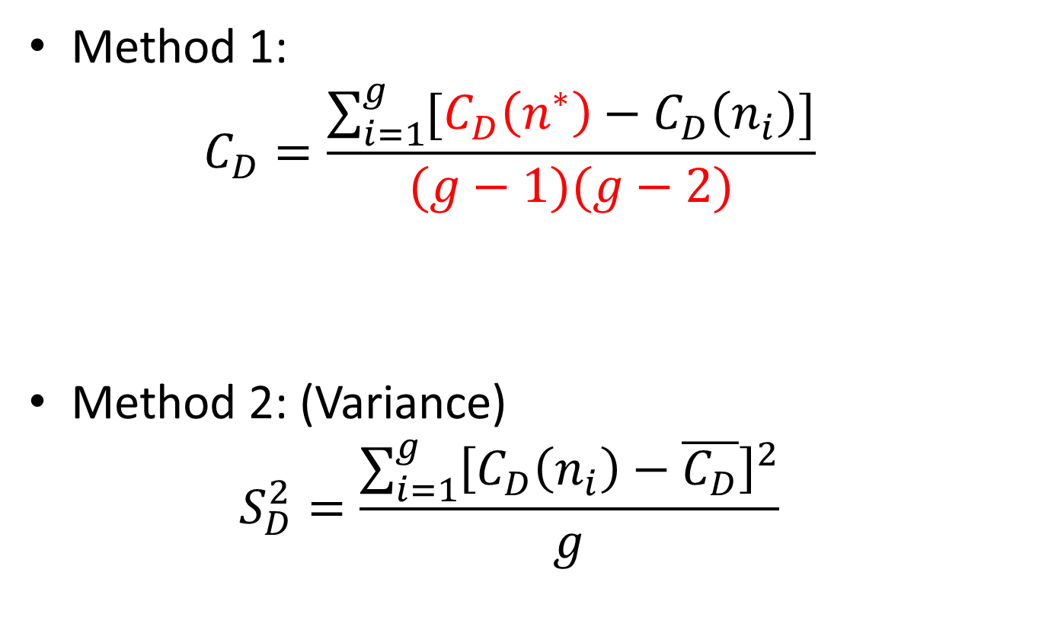
Centrality (1): Group Degree Centralization
Max actor degree centrality in this graph
Method 1: $C_{D}=\frac{\sum_{i=1}^{g}{[C_{D}\left(n^{∗}\right)−C_{D}\left(n_{i}\right)]}}{(g−1)(g−2)}$
Method 2: (Variance) $S_{D}^{2}=\frac{\sum_{i=1}^{g}{{\left[C_{D}\left(n_{i}\right)−\overline{C_{D}}\right]}^{2}}}{g}$
Group degree difference
Group degree difference of a Star graph

Slide 12
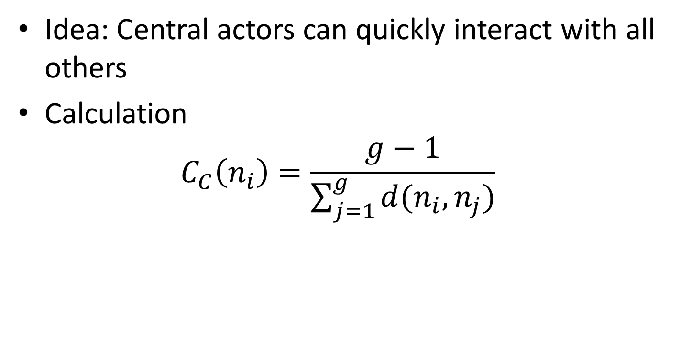
Centrality (2): Actor Closeness Centrality
Idea: Central actors can quickly interact with all others
Calculation $C_{C}\left(n_{i}\right)=\frac{g−1}{\sum_{j=1}^{g}{d(n_{i}, n_{j})}}$
Min possible value of the total distance
Total distances between all others and n_{i}
A star graph

Slide 13
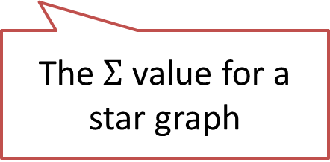
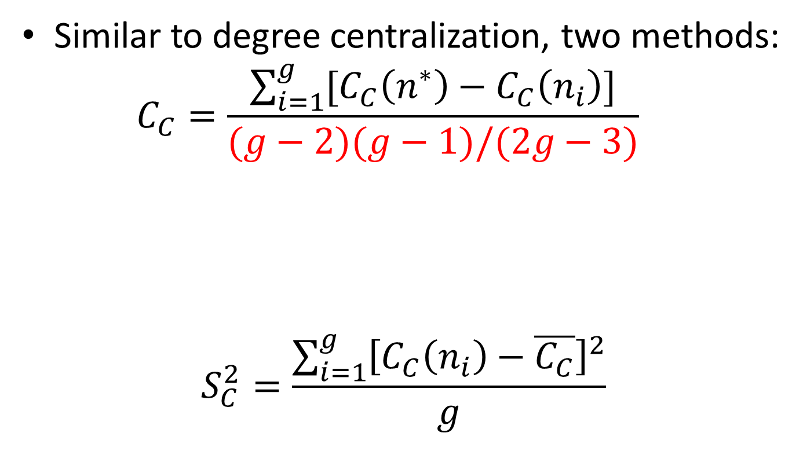
Centrality (2): Group Closeness Centralization
Similar to degree centralization, two methods: $C_{C}=\frac{\sum_{i=1}^{g}{[C_{C}\left(n^{∗}\right)−C_{C}\left(n_{i}\right)]}}{(g−2)(g−1)/(2g−3)}$
$$S_{C}^{2}=\frac{\sum_{i=1}^{g}{{\left[C_{C}\left(n_{i}\right)−\overline{C_{C}}\right]}^{2}}}{g}$$
The$Σ$ value for a star graph

Slide 14
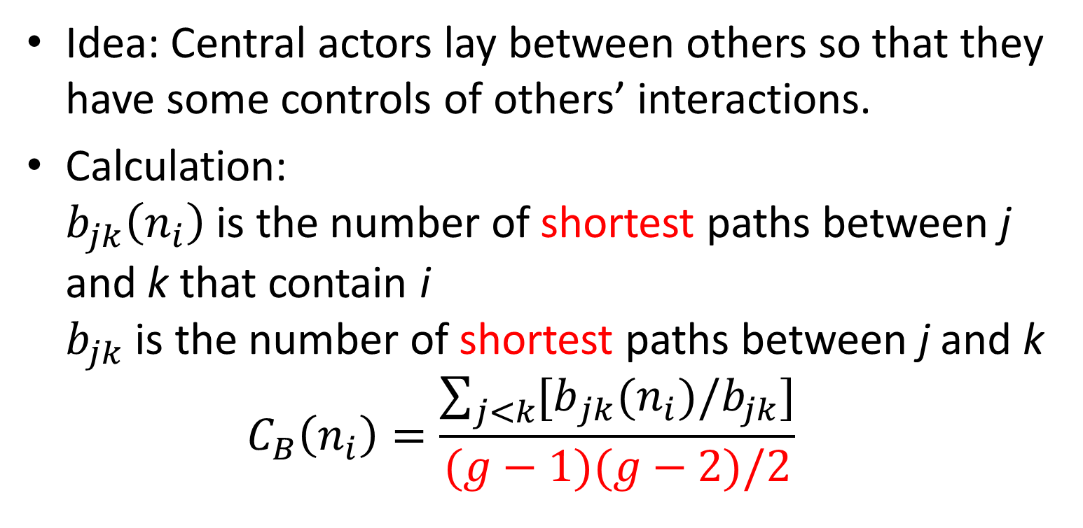
Centrality (3): Actor Betweenness Centrality
Idea: Central actors lay between others so that they have some controls of others’ interactions.
Calculation: $b_{jk}\left(n_{i}\right)$ is the number of shortest paths between j and k that contain i $b_{jk}$ is the number of shortest paths between j and k $C_{B}\left(n_{i}\right)=\frac{\sum_{j<k}{{[b}_{jk}(n_{i})/b_{jk}]}}{(g−1)(g−2)/2}$
A star graph

Slide 15


Centrality (3): Group Betweenness Centralization
$$C_{B}=\frac{\sum_{i=1}^{g}{[C_{B}\left(n^{∗}\right)−C_{B}\left(n_{i}\right)]}}{g−1}$$
The$Σ$ value for a star graph

Slide 16
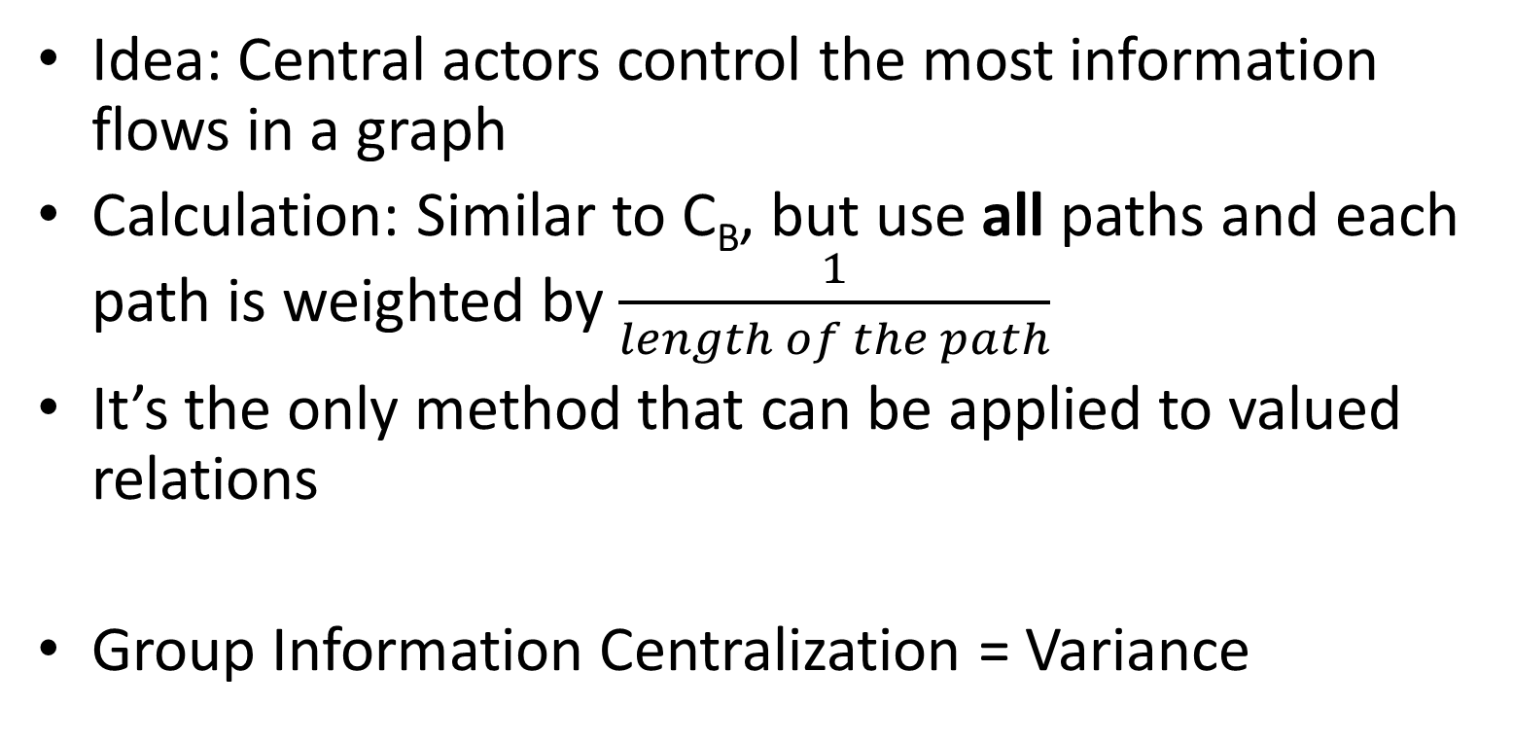
Centrality (4): Information Centrality
Idea: Central actors control the most information flows in a graph
Calculation: Similar to C_{B}, but use all paths and each path is weighted by $\frac{1}{length of the path}$
It’s the only method that can be applied to valued relations
Group Information Centralization = Variance

Slide 17

Prestige (1): Degree Prestige
Idea: Prestigious actors receives the most data
Calculation: $P_{D}\left(n_{i}\right)=\frac{d_{In}(n_{i})}{g−1}$
The in-degree of actor i

Slide 18
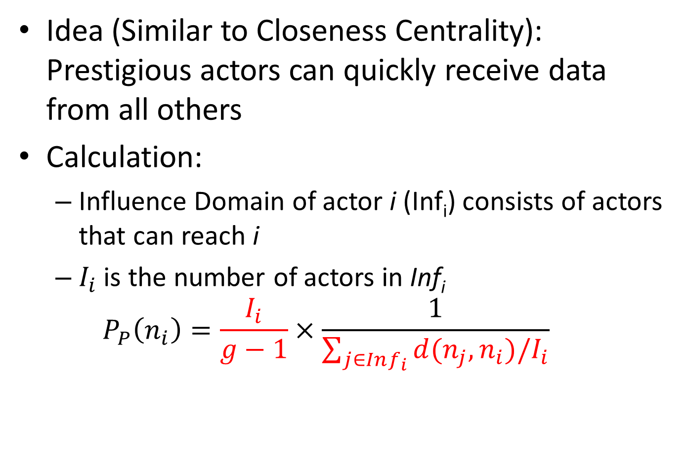
Prestige (2): Proximity Prestige
Idea (Similar to Closeness Centrality): Prestigious actors can quickly receive data from all others
Calculation:
Influence Domain of actor i (Inf_{i}) consists of actors that can reach i
$I_{i}$ is the number of actors in Inf_{i}
$$P_{P}\left(n_{i}\right)=\frac{I_{i}}{g−1}×\frac{1}{\sum_{j∈Inf_{i}}{d(n_{j}, n_{i})/I_{i}}}$$
The fraction of i’s influence domain
Average distance

Slide 19
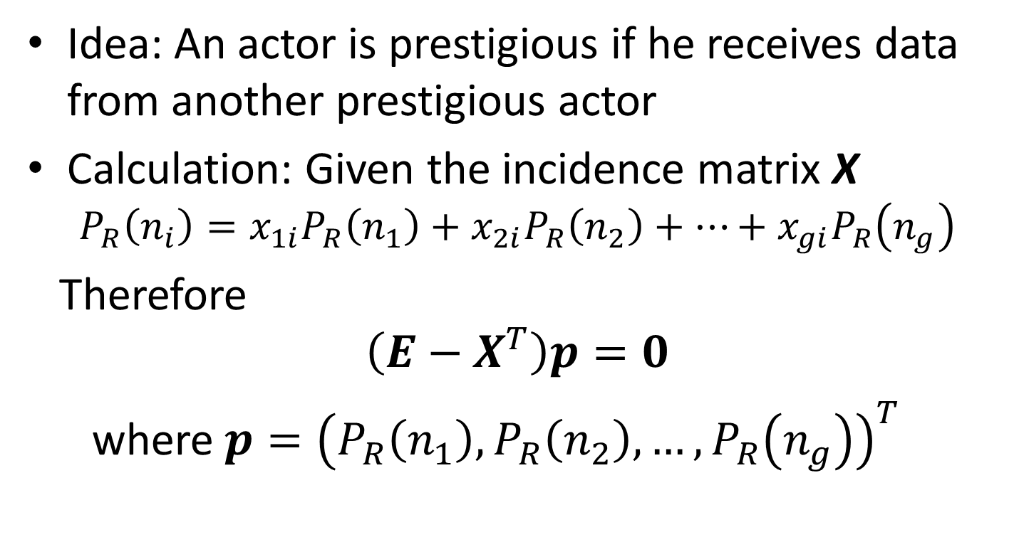
Prestige (3): Rank Prestige
Idea: An actor is prestigious if he receives data from another prestigious actor
Calculation: Given the incidence matrix X $P_{R}\left(n_{i}\right)=x_{1i}P_{R}\left(n_{1}\right)+x_{2i}P_{R}\left(n_{2}\right)+…+x_{gi}P_{R}\left(n_{g}\right)$
Therefore
$$\left(E−X^{T}\right)p=0$$
where $p={\left(P_{R}\left(n_{1}\right), P_{R}\left(n_{2}\right),…, P_{R}\left(n_{g}\right)\right)}^{T}$

Slide 20
Outline
Mathematical Preliminaries
Methods
Centrality and Prestige
Structural Balance
Cohesive Subgroups
Possible Applications in Our Work

Slide 21
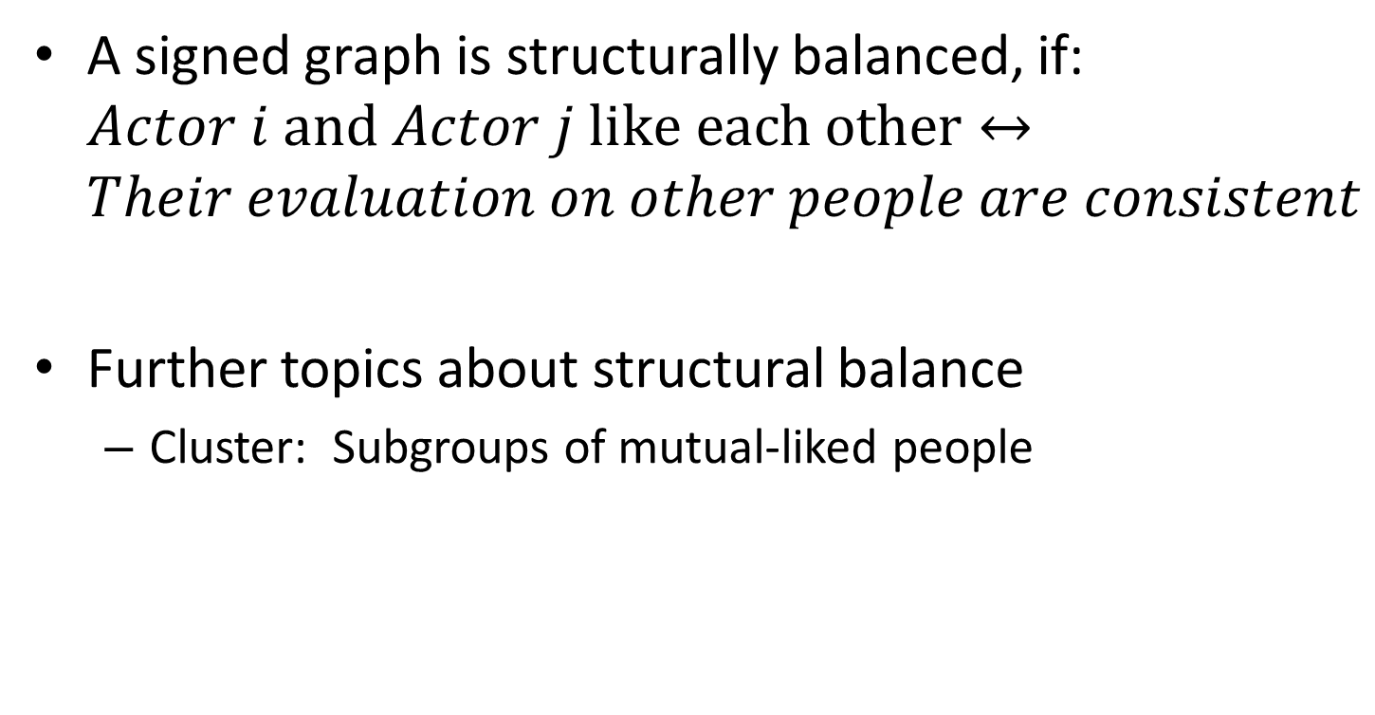
What is structural balance?
A signed graph is structurally balanced, if: $Actor i \text{and} Actor j \text{like} \text{each} \text{other}↔$ $Their evaluation on other people are consistent$
Further topics about structural balance
Cluster: Subgroups of mutual-liked people

Slide 22
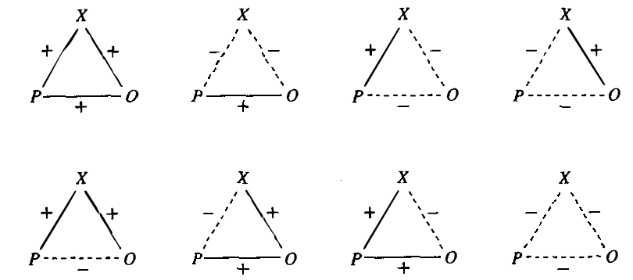
Cycle Balance (Nondirectional)
Attitude between P, O, and X
Positive Cycle
(Pleasing,
Balanced)
Negative Cycle
(Tension,
Not Balanced)
Definition: A cycle is positive iff it has even number of negative signs ($−$)

Slide 23
Structural Balance (Nondirectonal)
A signed graph is balanced iff all cycles are positive.
If a graph has no cycles, its balance is undefined (or vacuously balanced)

Slide 24
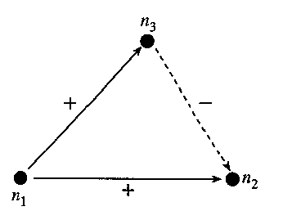
Balance: Directional
A signed digraph is balanced iff all semicycles are positive
Semicycles: Cycles that formed by ignoring the direction of edges
A negative semicycle

Slide 25







Clusterability
A signed graph is clusterable if it can be divided into many subsets such that positive lines are only inside subsets and negative lines are only across subsets.
Balanced graph has 1 or 2 clusters.
Unbalanced graph may have several (surely balanced) clusters. (Separation of Tensions)
$$−$$
$$+$$
$$+$$
$$−$$
$$−$$
$$−$$
$$+$$
A Clustering

Slide 26
Check Clusterability
A signed (di-)graph is clusterable iff it contains no (semi-)cycles which have exactly one negative line.
For a complete signed (di-)graph, the 4 statements are equivalent:
It is clusterable.
It has a unique clustering.
It has no (semi-)cycle with exactly one negative line.
It has no (semi-)cycle of length 3 with exactly one negative line.

Slide 27
Outline
Mathematical Preliminaries
Methods
Centrality and Prestige
Structural Balance
Cohesive Subgroups
Possible Applications in Our Work

Slide 28
Overview
Definitions of cohesive subgroups in a graph
Measures of subgroup cohesion in a graph
Extensions
Digraph
Valued Relation
Two-mode graph

Slide 29
Definitions of a Cohesive Subgroup (CS)
Four kinds of ideas to define a CS: Members of a CS would
interact with each other directly
interact with each other easily
interact frequently
interact more frequently compare to non-members

Slide 30
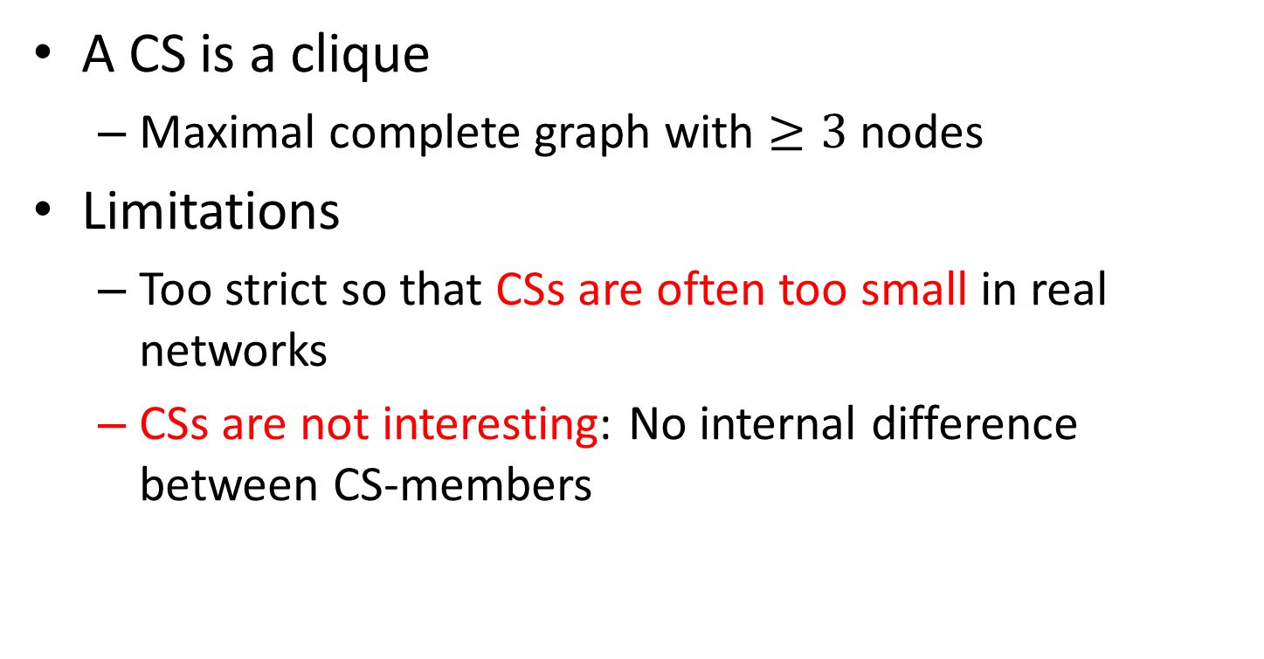
Definition (1/4): Based on Clique
A CS is a clique
Maximal complete graph with $≥3$ nodes
Limitations
Too strict so that CSs are often too small in real networks
CSs are not interesting: No internal difference between CS-members

Slide 31
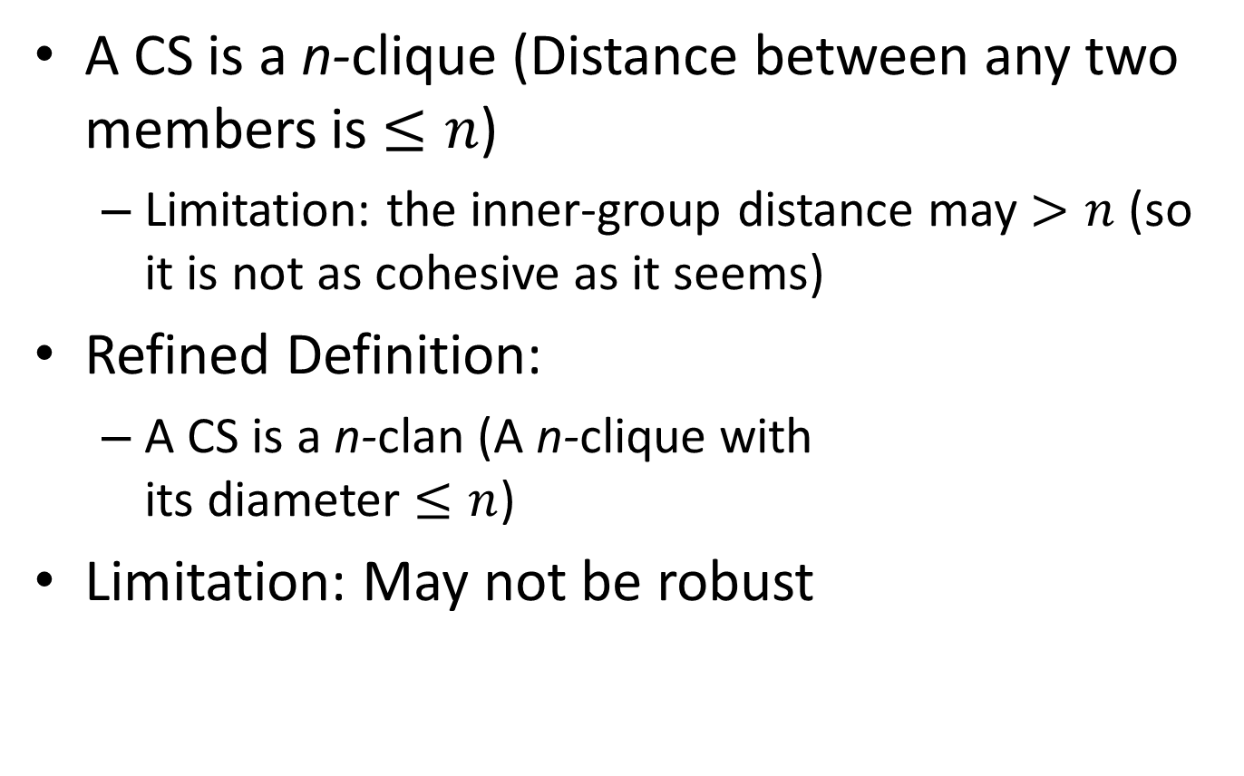
Definition (2/4): Based on Diameter
A CS is a n-clique (Distance between any two members is $≤n$)
Limitation: the inner-group distance may $>n$ (so it is not as cohesive as it seems)
Refined Definition:
A CS is a n-clan (A n-clique with its diameter $≤n$)
Limitation: May not be robust
X
Y
A 2-clique (X and Y are not close inside the clique)
(A fragile CS)

Slide 32
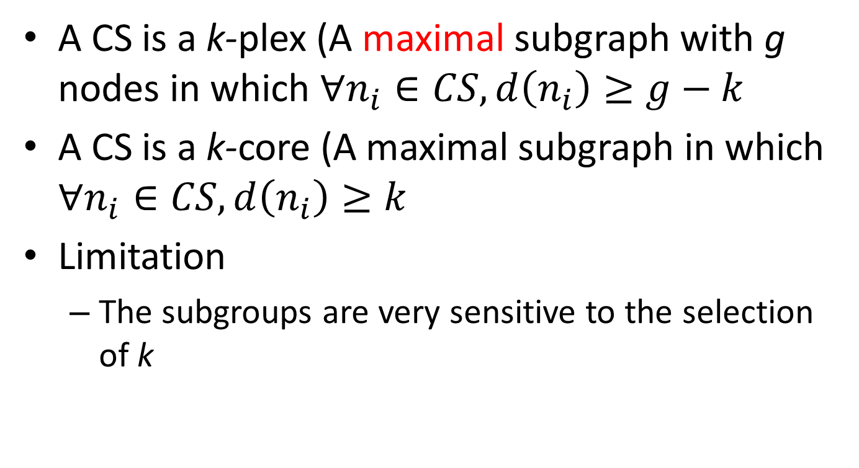
Definition (3/4): Based on Degree
A CS is a k-plex (A maximal subgraph with g nodes in which $∀n_{i}∈CS, d\left(n_{i}\right)≥g−k$
A CS is a k-core (A maximal subgraph in which $∀n_{i}∈CS, d\left(n_{i}\right)≥k$
Limitation
The subgroups are very sensitive to the selection of k

Slide 33
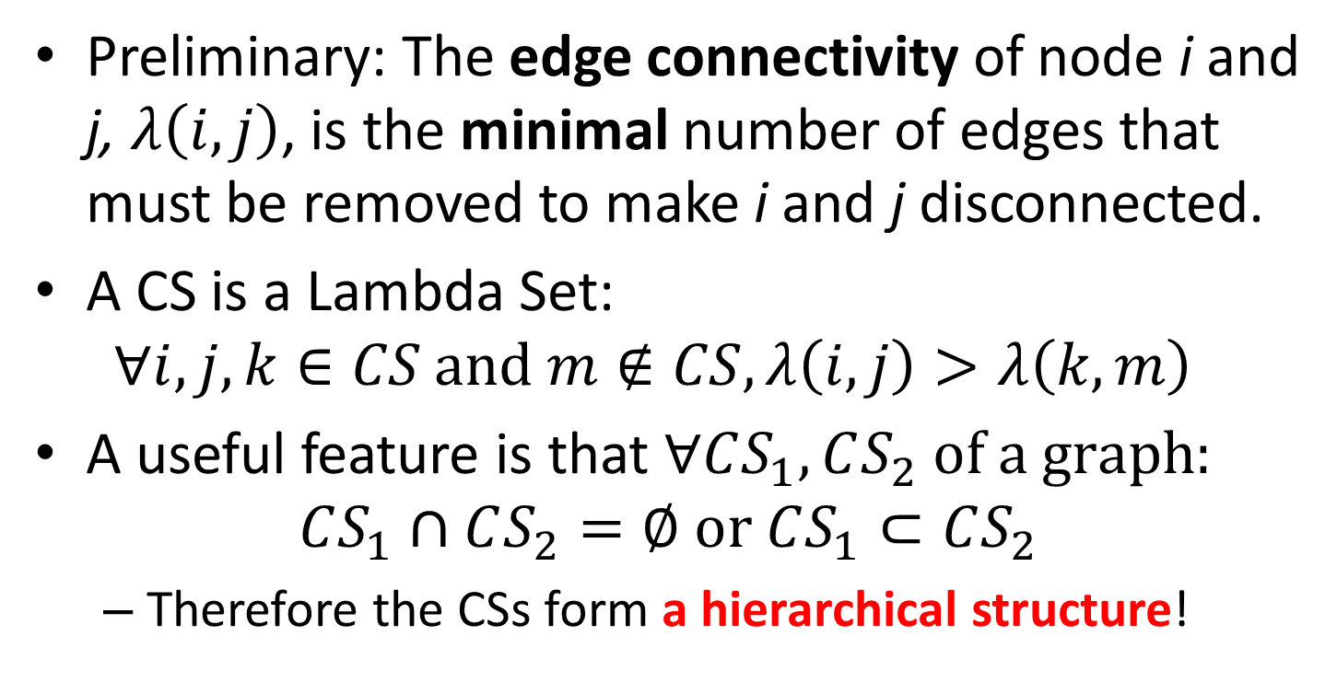
Definition (4/4): Based on Inside-Outside Relations
Preliminary: The edge connectivity of node i and j, $λ\left(i,j\right)$, is the minimal number of edges that must be removed to make i and j disconnected.
A CS is a Lambda Set: $∀i,j,k∈CS \text{and} m∉CS, λ\left(i, j\right)>λ\left(k, m\right)$
A useful feature is that $∀CS_{1},CS_{2} \text{of} \text{a} \text{graph}:$ $CS_{1}∩CS_{2}=∅ \text{or} CS_{1}⊂CS_{2}$
Therefore the CSs form a hierarchical structure!

Slide 34
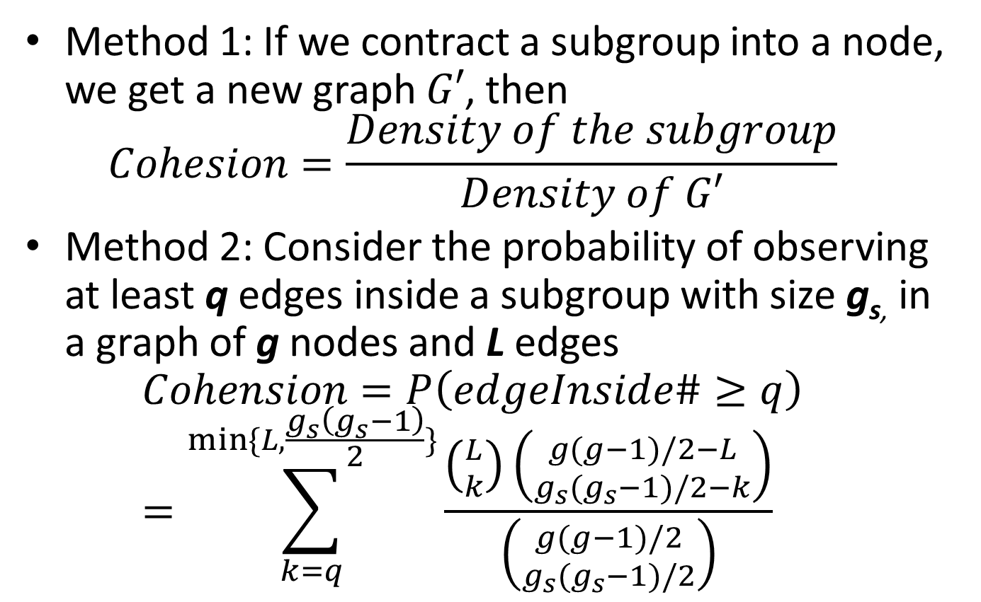
Measure the Subgroup Cohesion
Method 1: If we contract a subgroup into a node, we get a new graph $G′$, then $Cohesion=\frac{Density of the subgroup}{Density of G′}$
Method 2: Consider the probability of observing at least q edges inside a subgroup with size g_{s,} in a graph of g nodes and L edges $Cohension=P\left(edgeInside\#≥q\right)$ $=\sum_{k=q}^{min⁡\{L,\frac{g_{s}\left(g_{s}−1\right)}{2}\}}{\frac{\left({L \atop k}\right)\left({g(g−1)/2−L \atop g_{s}(g_{s}−1)/2−k}\right)}{\left({g(g−1)/2 \atop g_{s}(g_{s}−1)/2}\right)}}$

Slide 35
Extension (1/3): Digraph
For definition 1: clique for digraph
For definition 2 to 4 (all care about connectivity) Use one of these digraph-connectivities:
Weakly connected: a semipath between i and j
Unilaterally connected: a path from either i to j or j to i
Strongly connected: Both paths from i to j and j to i
Recursively connected: i and j are strongly connected, and the forward and backward paths contain the same nodes and arcs

Slide 36
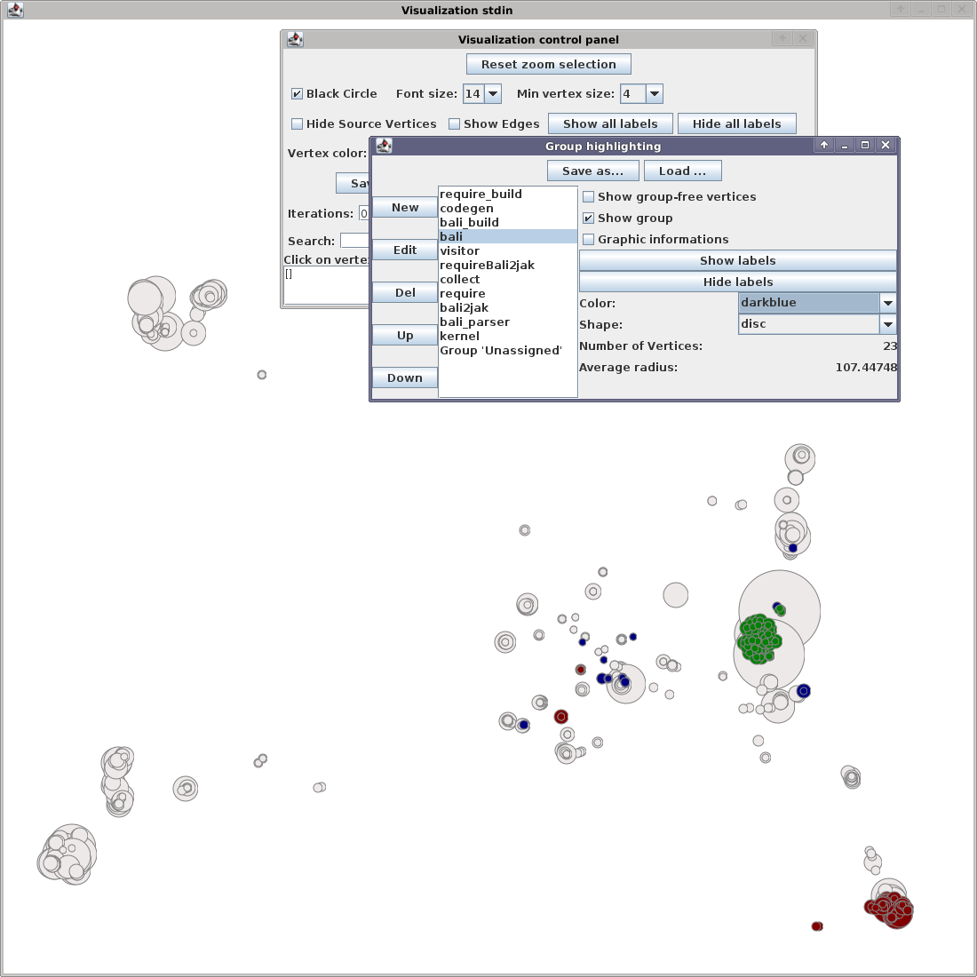
An Example Application: Code to Feature
Actor = Class, Function
Edge = Call, Reference, …
Cohesive Subgroup = Feature
Measure the cohesion visually
Sven Apel, Dirk Beyer. Feature Cohesion in Software Product Lines :An Exploratory Study. ICSE ‘11

Slide 37

Extension (2/3): Valued Relation
Connectivity at Level C
i and j are connected at level C if all the edges in the (semi-)path are valued $≥C$
Cohesive Subgroup at Level C
5
2
4
3
Cohesive Group at Level 2

Slide 38
Extension (3/3): Two-Mode Networks
A two-mode network: Two kinds of nodes (actors and events), relations are between different kinds of nodes
Represent two-mode networks
Affiliation Matrix
Bipartite Graph
Hypergraph
Affiliate
Club 2
Student 1
Students
Clubs
Student 2
Club 1
ACTOR
EVENT
Student 3
Club 3

Slide 39
Idea 1: Convert Two-Mode to One-Mode
Convert into 2 graphs:
(Similar Actors) Co-membership Valued Graph: i links to j at value C iff Actor i and actor j affiliate C same events.
(Similar Events) Overlap Valued Graph: i links to j at value C iff Event i and event j own C same actors.
Apply one-mode network analysis methods to these graphs

Slide 40
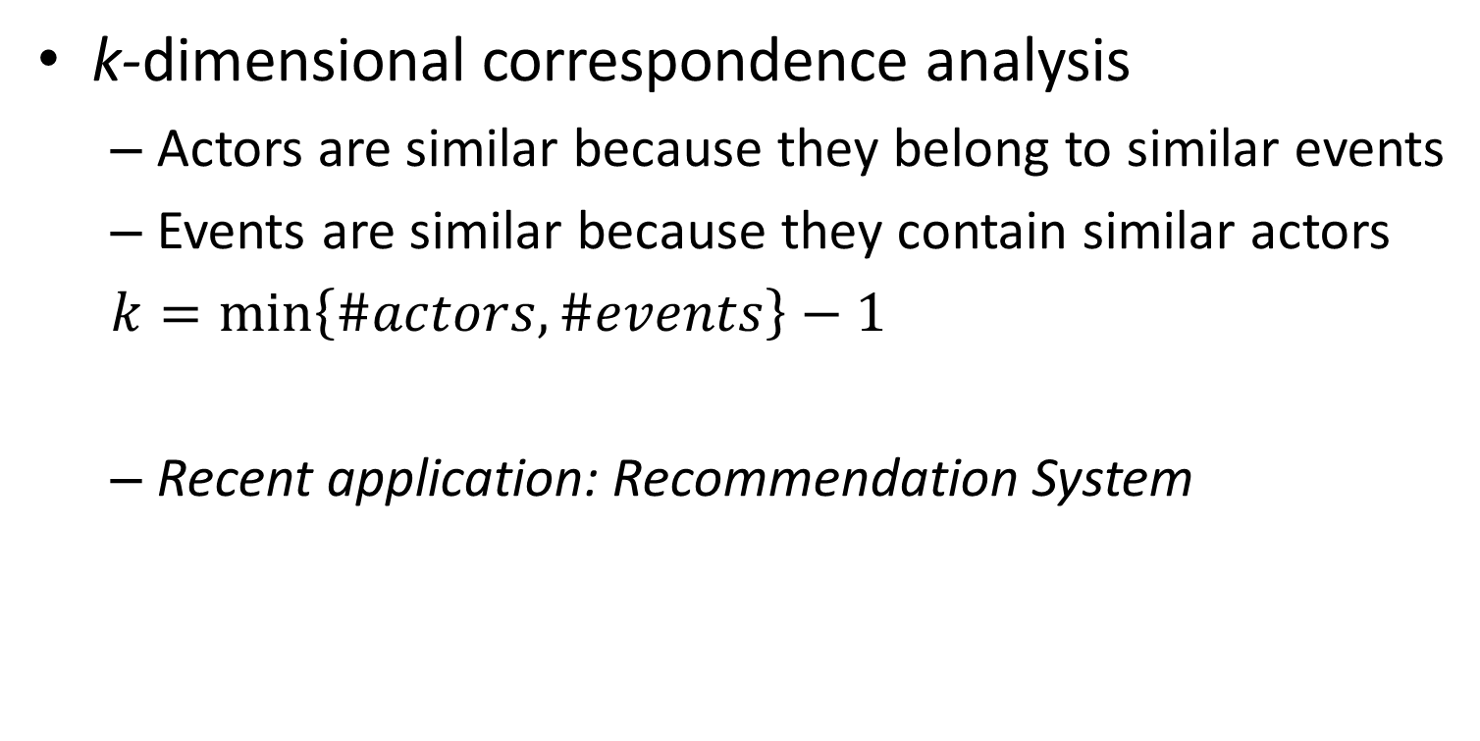
Idea 2: Consider actors and events together
k-dimensional correspondence analysis
Actors are similar because they belong to similar events
Events are similar because they contain similar actors
$k=\min\left\{\#actors, \#events\right\}−1$
Recent application: Recommendation System

Slide 41
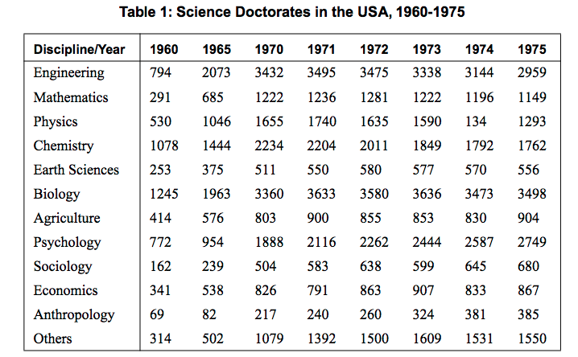
Example: Input Data

Slide 42
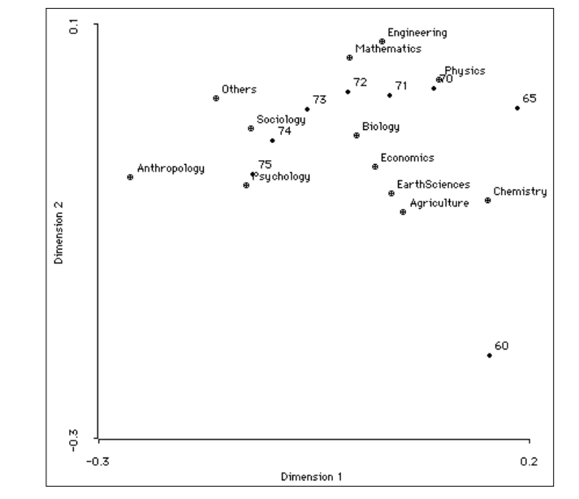
Example: 2-Dimensional Correspondence Analysis
Close points have similar profiles.

Slide 43
Outline
Mathematical Preliminaries
Methods
Centrality and Prestige
Structural Balance
Cohesive Subgroups
Possible Applications in Our Work

Slide 44

Our Work: Collaborative Feature Modeling
stimulate
Feature Model (Inner Knowledge)
stimulate
perform
perform
Person Y
Person X
Mash
Modeling Activities
Outter
Knowledge
Modeling Activities
Create
Select
Directly Affect
Directly Affect
Books
Documents
Codes
…
View
Deny
Indirectly Affect
Indirectly Affect
Personal View X
Personal View Y
Eco-system Boundary
For Personal Use
For Personal Use
An Overview of CoFM Eco-system

Slide 45
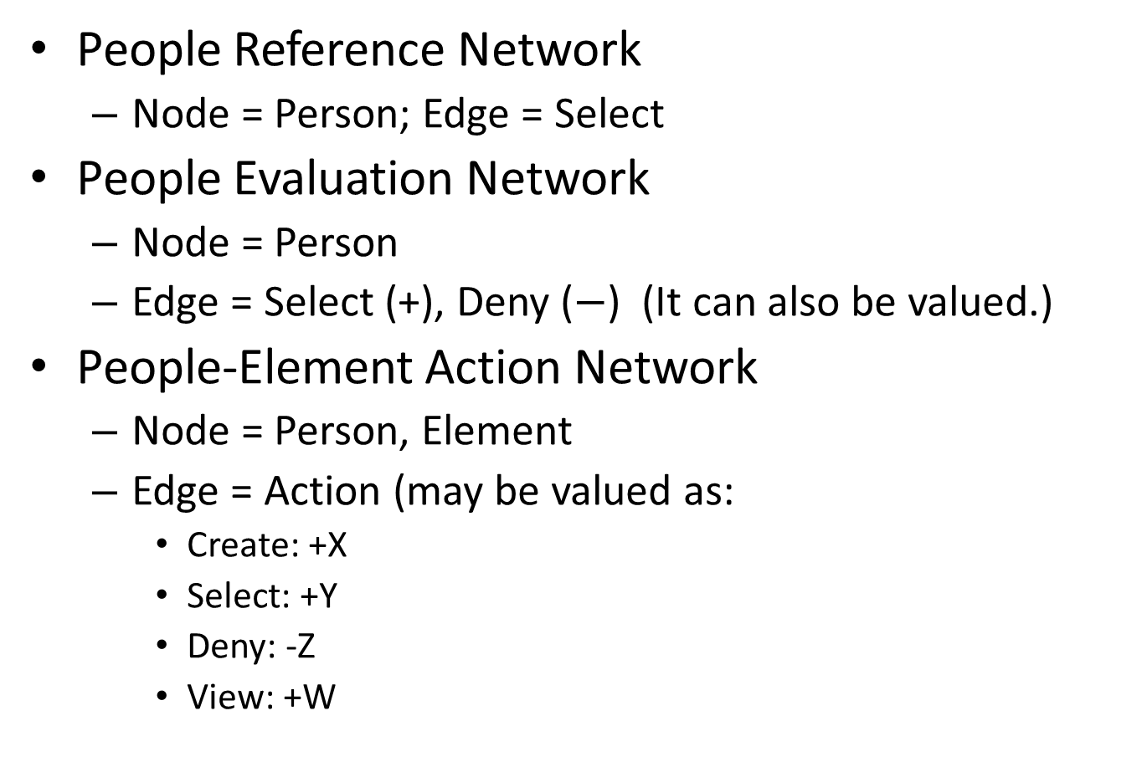
Possible Networks in CoFM
People Reference Network
Node = Person; Edge = Select
People Evaluation Network
Node = Person
Edge = Select (+), Deny ($−$) (It can also be valued.)
People-Element Action Network
Node = Person, Element
Edge = Action (may be valued as:
Create: +X
Select: +Y
Deny: -Z
View: +W

Slide 46
THANK YOU!

